Slide 1
Delivery Date Prediction
Predicting the delivery dates of orders of an e-commerce business based on location, quantity and other parameters
Team Trio:
Harika Nalam
Sharad Nataraja
Shreya Nimbhorkar

Slide 2
Agenda
What are we trying to solve?
What data are we using?
Data Pre-processing
Feature engineering and EDA
How did we build the model?
Handling big data
AutoML

Slide 3
The problem statement
E-commerce is a huge industry now. When the consumers place orders with the company, the company is obliged to ship it to the customer.
This process includes the seller packing the item and then handing it to the carrier.
The carrier then transports the package to the destination.
In this project our goal is to predict the number of days it takes for the order to be delivered once the payment is made to the merchant.
We are trying to predict the number of days it takes for the merchant to handover the package to the carrier(handling days) and the number of days it takes for the carrier to transport the package to the destination(carrier transit time).

Slide 4





Practical uses
Any business that has e-commerce collaborate with delivery services. This model can be used to train and predict the days to delivery and convey the same to customers.

Slide 5
The Dataset
We have used a real-world dataset which is anonymized.
We are dealing with big data. The number of records are in millions.
We are also using publicly available US zip code datasets to calculate distances and derive more data regarding distances, time zones, and state names.
To understand the data, to perform pre-processing and EDA, we have sampled the data randomly so we can easily manage the computing needed to work with Big data.

Slide 6
The Orders dataset
The data set contains information regarding the type of transaction, the date when the order was placed, the required handling days, the seller zip, buyer zip, the category of the item, shipping method. Priority, quantity, carrier estimates for delivery.
We have categorical data, datetime data, zip code data ,numeric data and text.
Data annexure

Slide 7
Data Pre-processing
The data is not particularly noisy. However, we did find empty fields, outliers, and wrong formatting with the data.
We have handled the null values by either eliminating them where they are not significant in proportion and imputing the values where they are significant. We found outliers in terms of carrier estimates, quantities and the handling days.
We then have encoded the data for categorical values. We have extracted information like the time zones and dates from datetime data.

Slide 8
Data Pre-processing
We have then created the following features using the available data.
Shipping distance
Actual carrier transit days
Actual handling days
Buyer time zone.
Seller time zone.

Slide 9
Exploratory Data Analysis
Using the existing features and the newly derived features we have found the following insights.
There is no correlation between the shipping distance and carrier estimates
No relation between package size and delivery time.
Consumer to consumer transaction take more handing time than a B2C or B2B transactions
If quantities are less than a certain value, there are some cases where the handling time has increased.
Generally, the actual handling days is towards the lower side of the estimate

Slide 10
Exploratory Data Analysis
This gave us pretty good insights as to what data to use to train our model.
The features that were selected to train the model are as follows.
Type of transaction (B2B_B2C)
Shipping method
Shipping distance
Quantity
Carrier minimum and maximum estimates
Actual carrier time
Declared handling time and actual handling time
Colab

Slide 11
Model
As reviewed in the previous slide, we used the features to train the model.
The model uses a regression algorithm to predict the days to delivery.
We have also tried with other algorithms like Xgboost and decision tree.
The model is deployed such that it can be invoked using a web UI. It is deployed on Heroku.

Slide 12
Handling Big data
The size of our data is enormous.(15000000 * 19).To train the model using such large data would need serious compute capacity.
We will be hosting the model on a cloud-based spark architecture to provide the computing capacity. The model and its pipelines can be invoked using this distributed architecture to handle large volumes of data.
We also need a storage solution to store the massive data. We will be using an AWS S3 to store the data and AWS redshift to get a query able version of our data to use in the model.

Slide 13
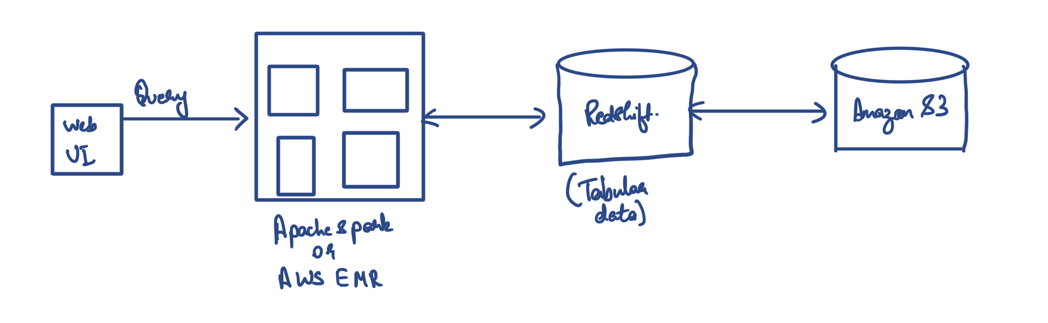
Handling Big Data

Slide 14
Further Improvements
We would like to use a feedback mechanism to use active learning within our model.
Also, we can use various other models to compare and select the best model.
We can also utilize AutoML tools like Azure ML, AWS sagemaker, Vertex AI etc.. to use an already trained model or use parameter tuning features to enhance the accuracy of the model.

Slide 15
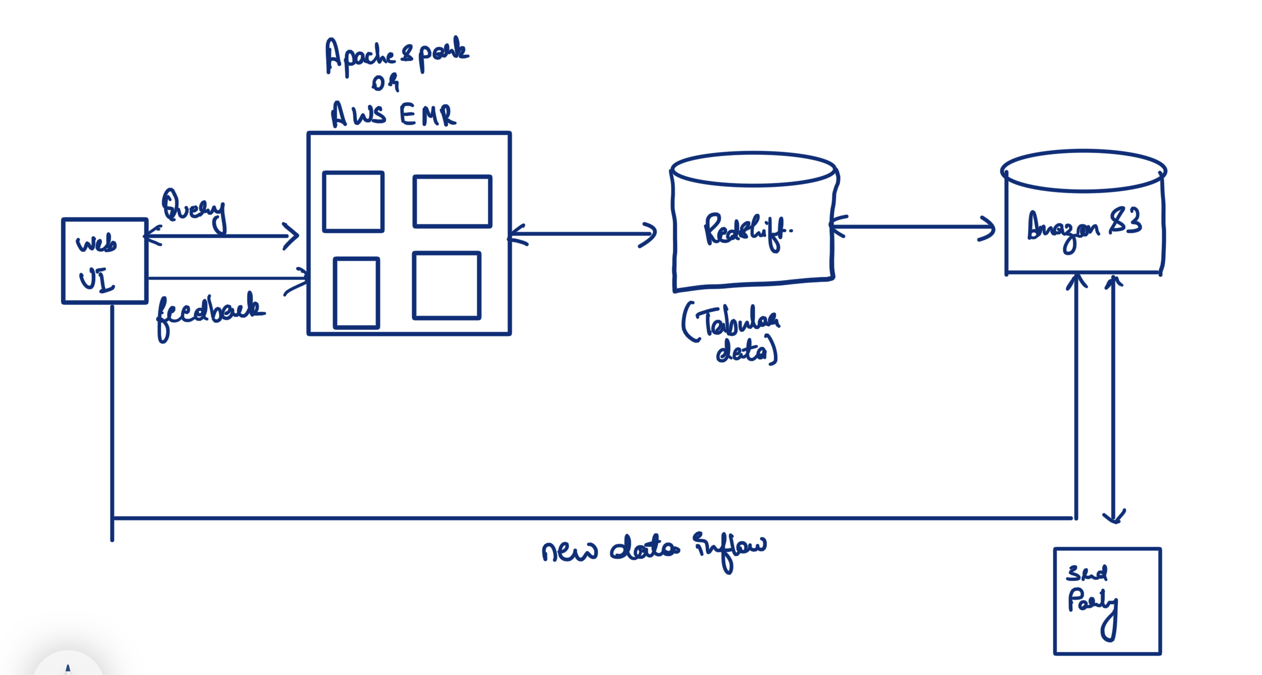
Further Improvements

Slide 16
DEMO

Slide 17
Thanks you!!
Any questions???

